Slide 1
PLC TRAINING BATAM
0821-7777-4411 (TSEL)

Slide 2
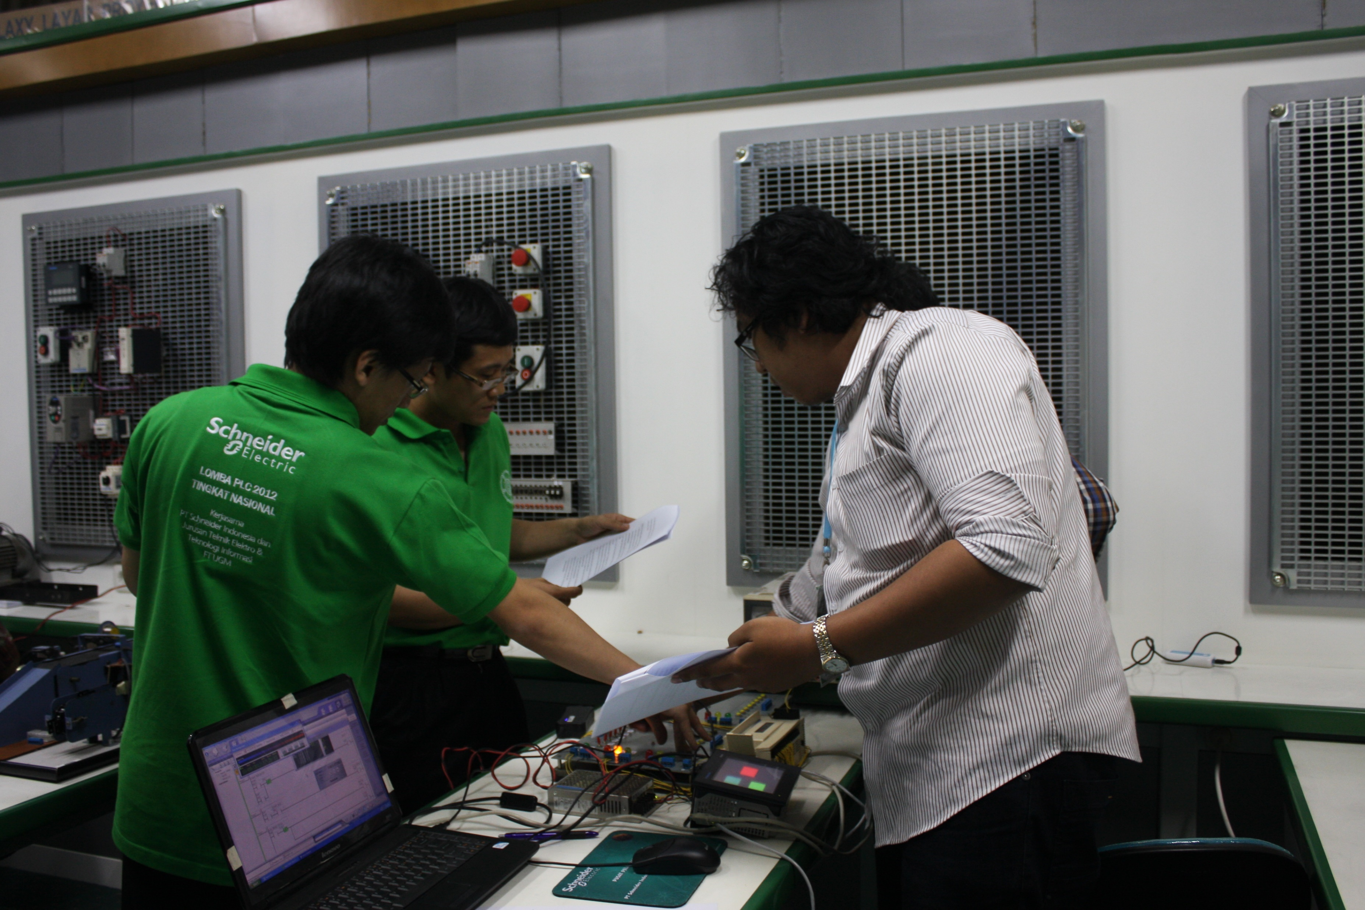
PLC TRAINING BATAM 0821-7777-4411 (TSEL)

Slide 3
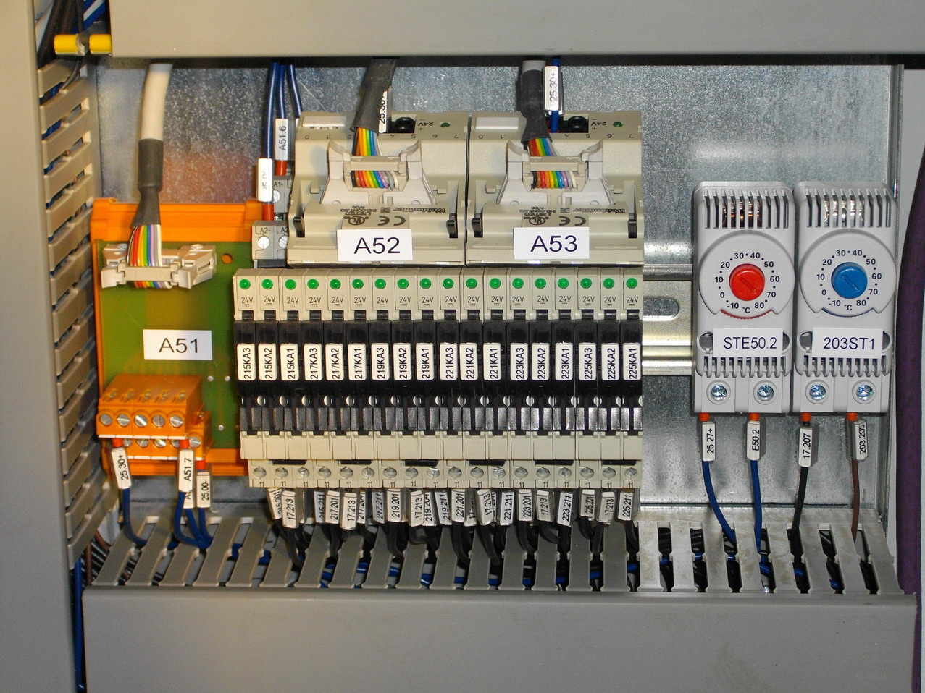
PLC TRAINING BATAM 0821-7777-4411 (TSEL)

Slide 4
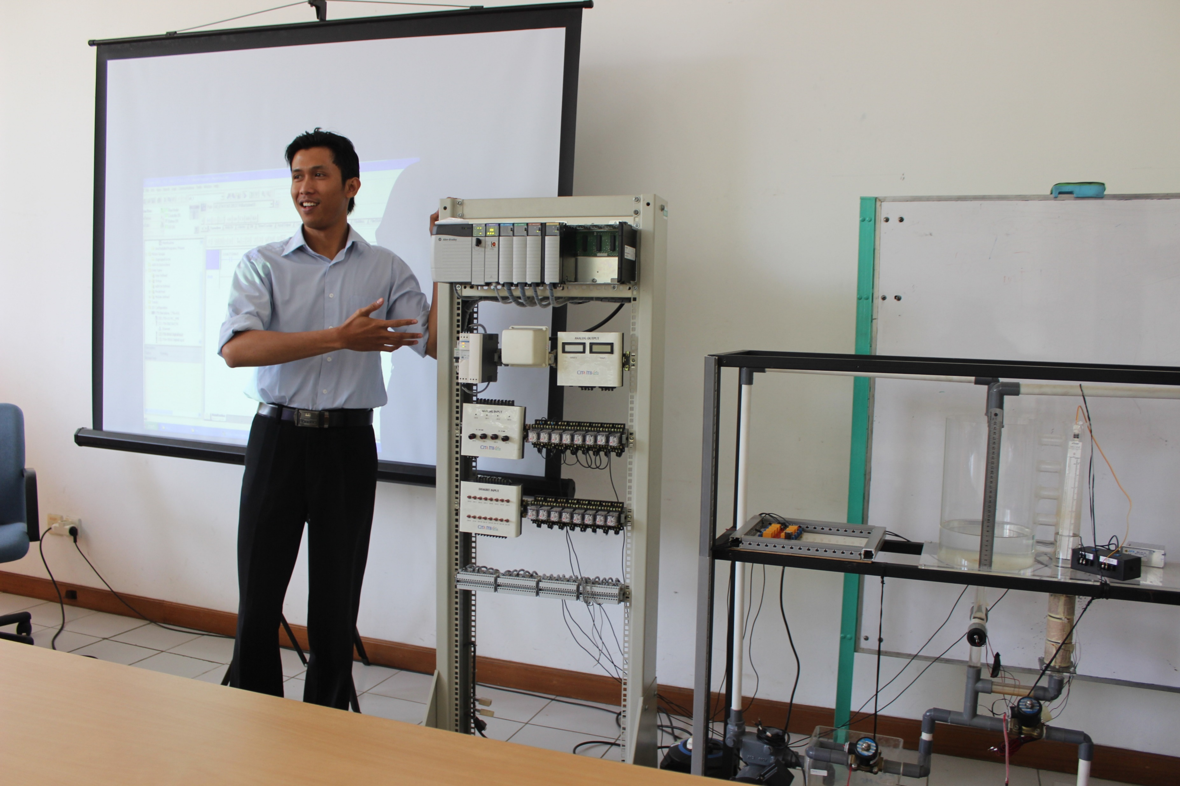
PLC TRAINING BATAM 0821-7777-4411 (TSEL)

Slide 5
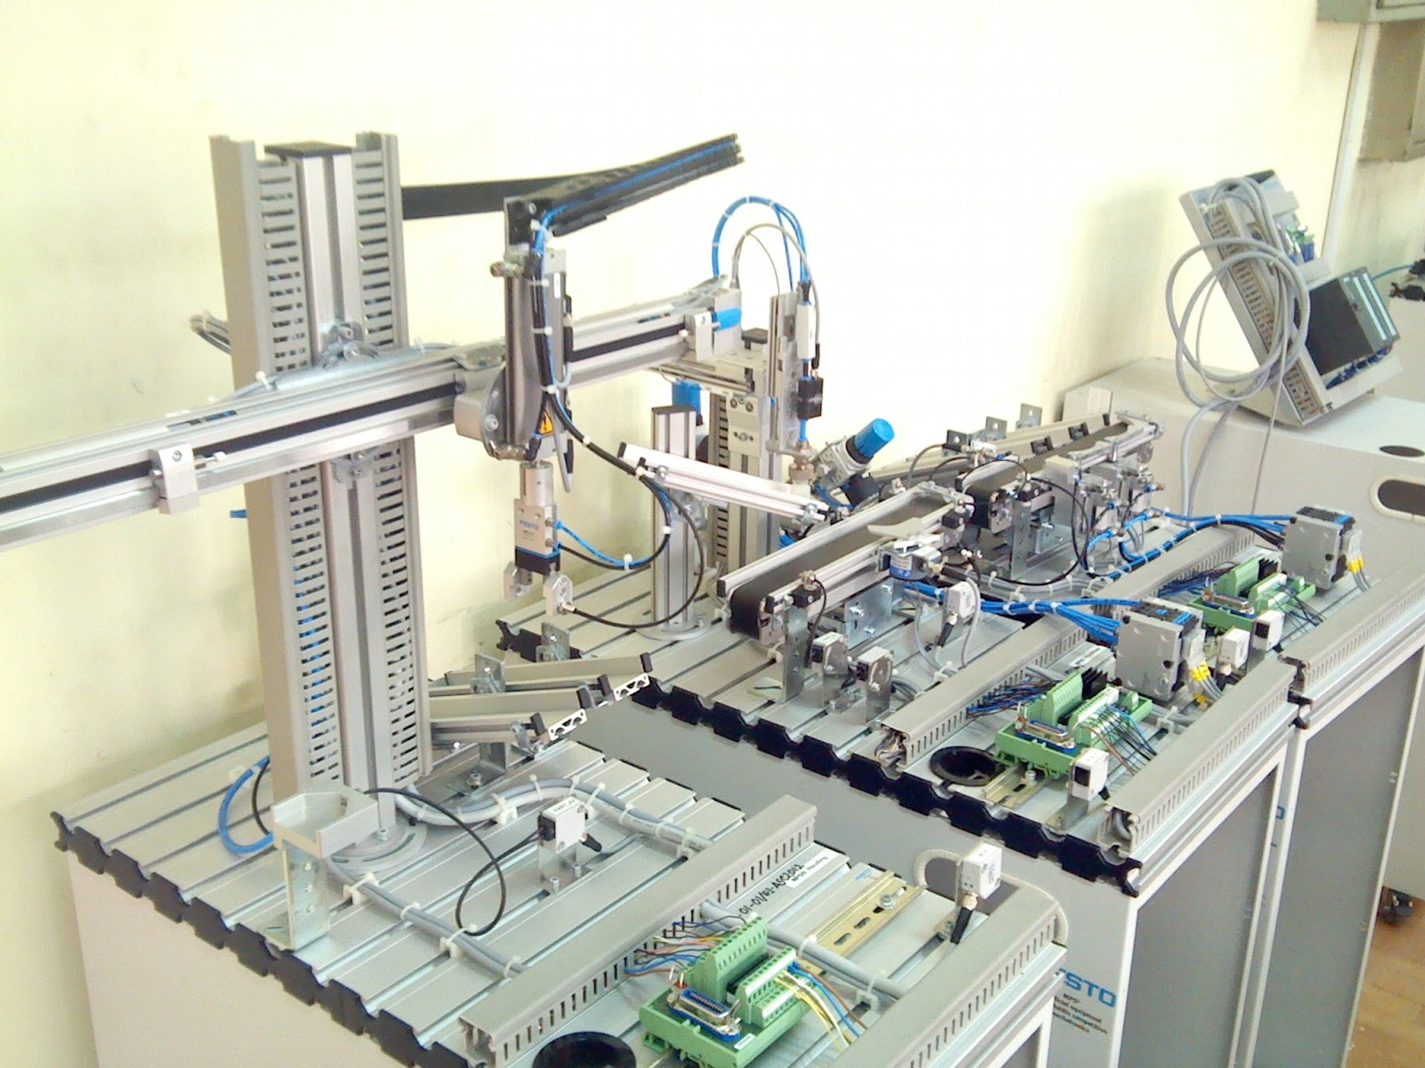
PLC TRAINING BATAM 0821-7777-4411 (TSEL)

Slide 6
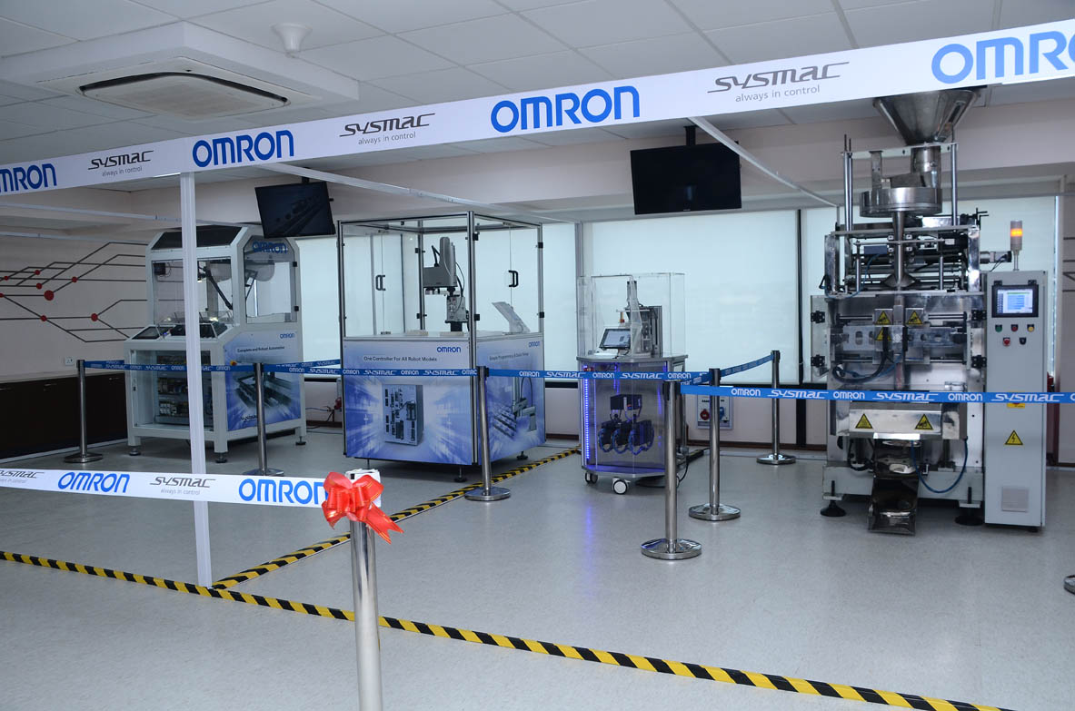
PLC TRAINING BATAM 0821-7777-4411 (TSEL)

Slide 7
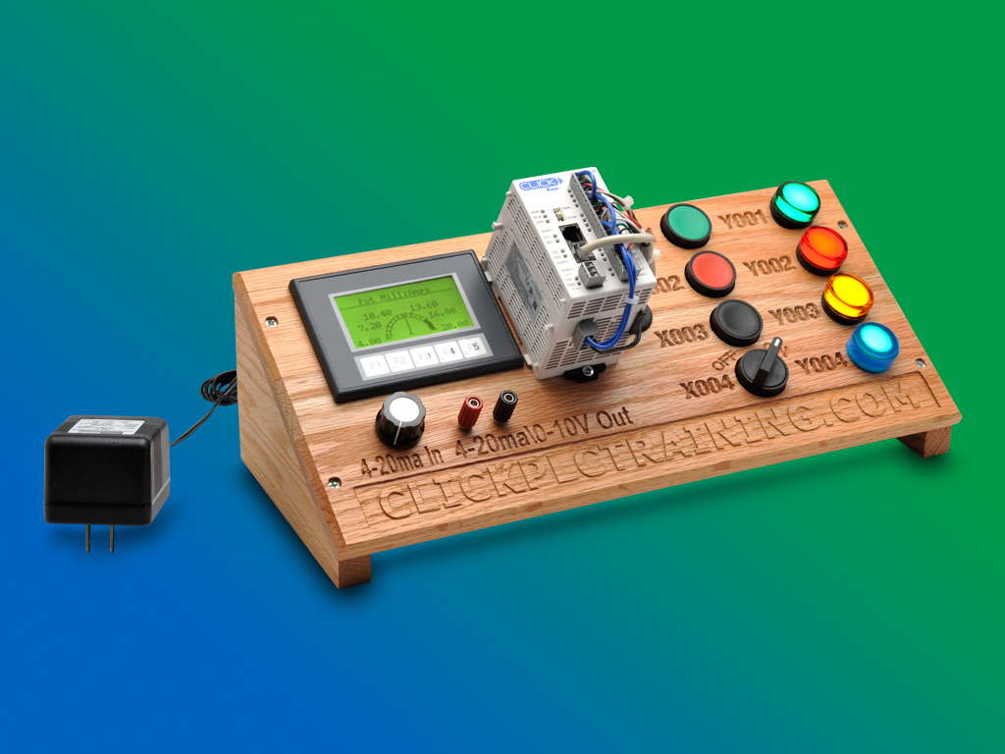
PLC TRAINING BATAM 0821-7777-4411 (TSEL)

Slide 8
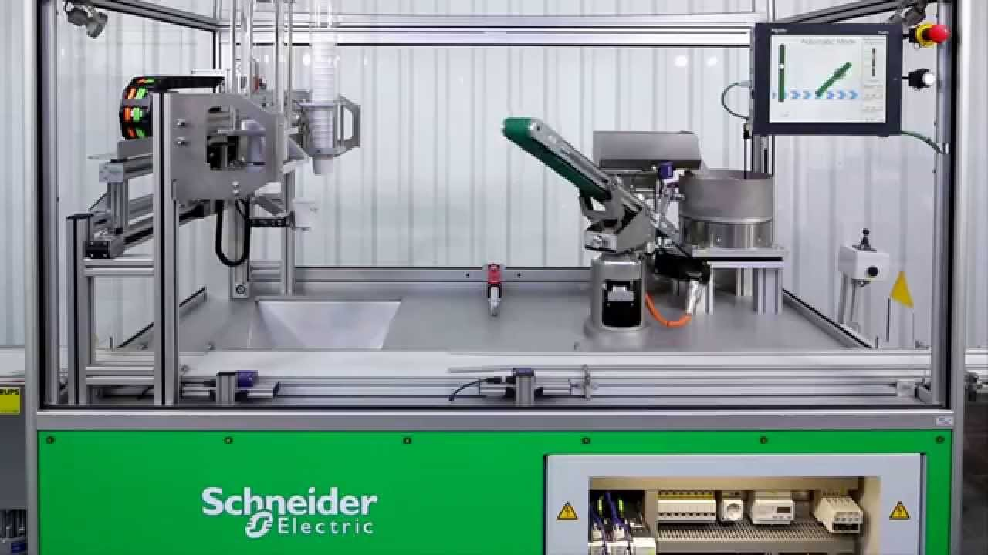
PLC TRAINING BATAM 0821-7777-4411 (TSEL)

Slide 9
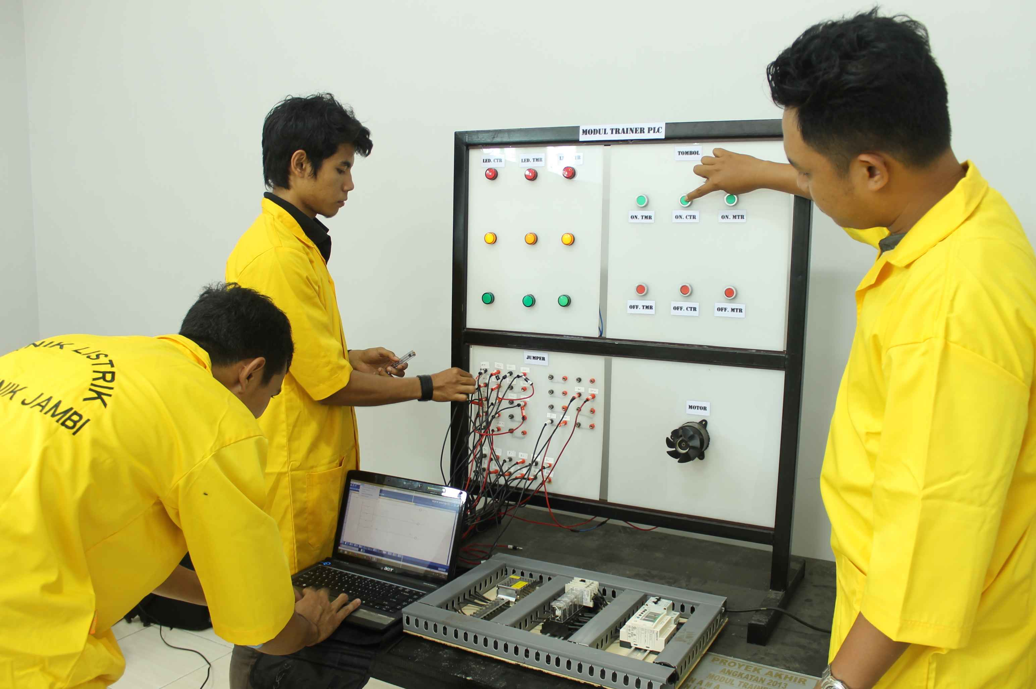
PLC TRAINING BATAM 0821-7777-4411 (TSEL)

Slide 10
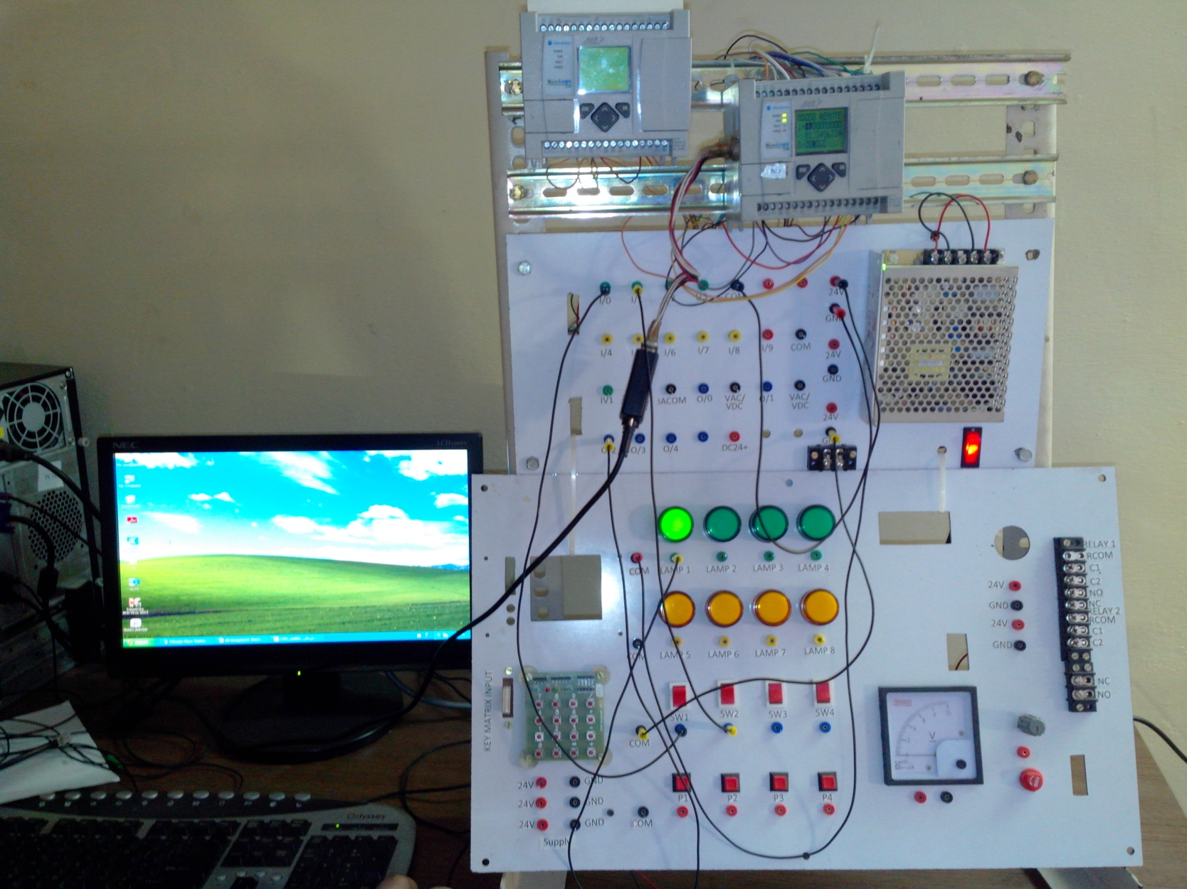
PLC TRAINING BATAM 0821-7777-4411 (TSEL)

